Slide 1

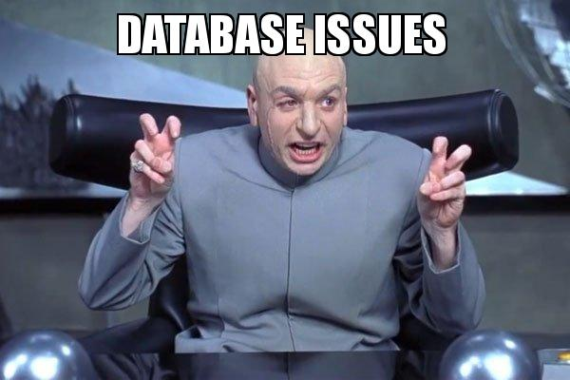
Project 3 – Data Clean Entrepreneurial competency
Edgar - Mathieu

Slide 2
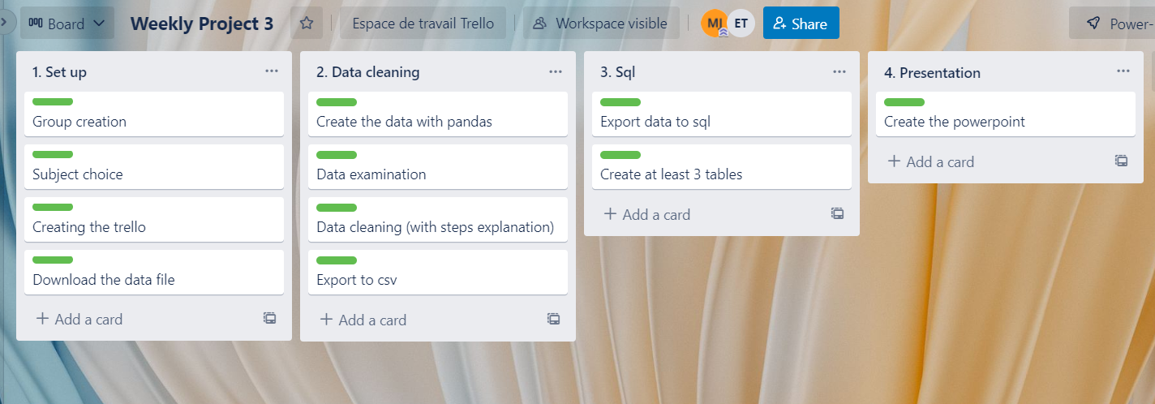
Project 3 – Data Clean Entrepreneurial competency
Planning - Trello

Slide 3
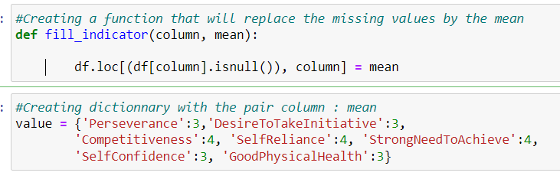
Project 3 – Data Clean Entrepreneurial competency
Descripton of project
Download the database about entrepreneurial competency
Examine data
Data cleaning
Export to csv the cleaned database
Export database to SQL
Create queries
Example of cleaning steps

Slide 4
Project 3 – Data Clean Entrepreneurial competency
SQL – Script - Queries
Create some queries to get insight about the database
Query 1: Understand the distribution of the database
Query 2: What are the educational sectors with most student with entrepreneurial competency
Query 3: What is the most returning key trait for student with entrepreneurial competency
Query 4: Number of student with entrepreneurial competency that have a mental disorder

Slide 5
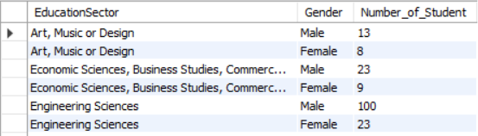
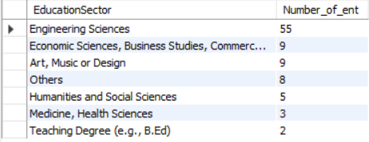
Project 3 – Data Clean Entrepreneurial competency
Some results
Query 1
Query 2

Slide 6
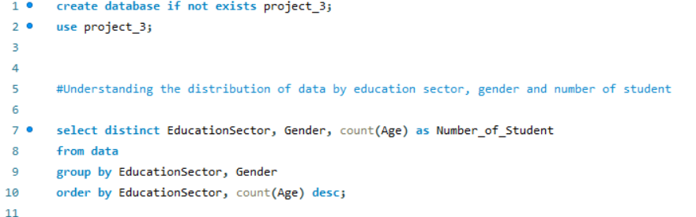
Project 3 – Data Clean Entrepreneurial competency
Demo

Slide 7
Project 3 – Data Clean Entrepreneurial competency
Questions
Q & A
TIME

Slide 8
Project 3 – Data Clean Entrepreneurial competency
End
Thanks

